Slide 1
实验六
Wireshark DNS
3 学时

Slide 2
实验目的
掌握Wireshark抓包工具分析DNS原理。

Slide 3
实验内容概览
Nslookup
ipconfig
Tracing DNS with Wireshark

Slide 4
Nslookup
nslookup tool allows the host running the tool to query any specified DNS server for a DNS record. The queried DNS server can be a root DNS server, a top-level-domain DNS server, an authoritative DNS server, or an intermediate DNS server.
nslookup sends a DNS query to the specified DNS server, receives a DNS reply from that same DNS server, and displays the result.

Slide 5
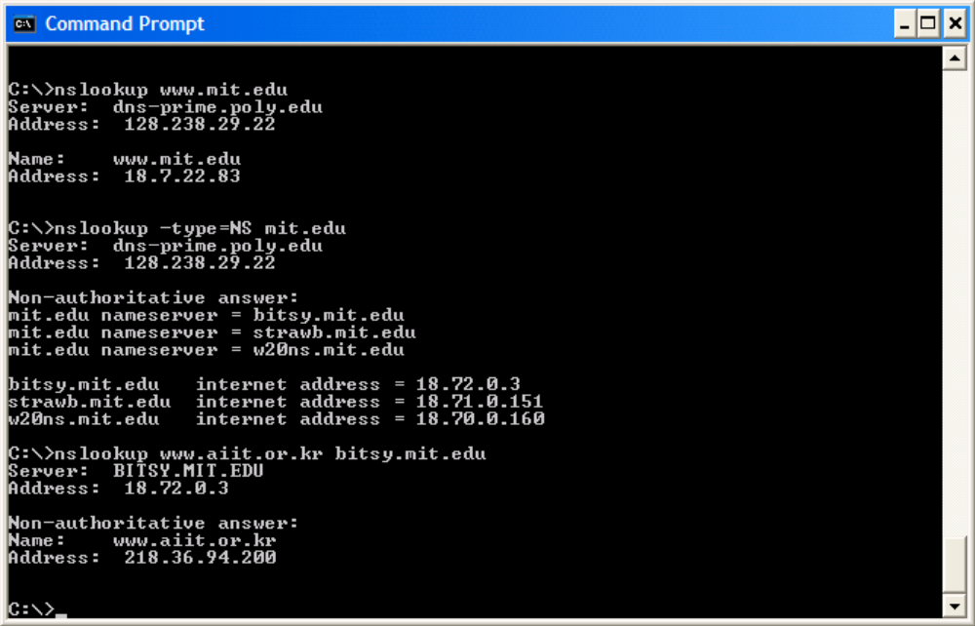
Nslookup
Please send me the IP address for the host
www.mit.edu
default local DNS server
Please send me the host names of the
authoritative DNS for mit.edu
this answer came from the cache of some
server rather than from an authoritative
MIT DNS server
query sent to the DNS server
bitsy.mit.edu rather than to the
default DNS server
Notes:
authoritative DNS—权威域名服务器

Slide 6
Nslookup
Now that we have provided an overview of nslookup, it is time for you to test drive it yourself. Do the following (and write down the results):
Run nslookup to obtain the IP address of a Web server in Asia. What is the IP address of that server?
2. Run nslookup to determine the authoritative DNS servers for a university in Europe.
Run nslookup so that one of the DNS servers obtained in Question 2 is queried for the mail servers for Yahoo! mail. What is its IP address?

Slide 7
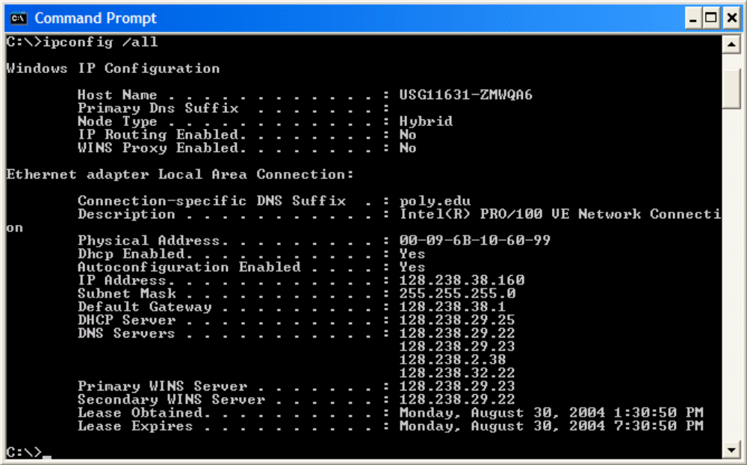
ipconfig
ipconfig \all

Slide 8
ipconfig
ipconfig /displaydns
Each entry shows the remaining Time to Live (TTL) in seconds. To clear the cache, enter
ipconfig /flushdns
Flushing the DNS cache clears all entries and reloads the entries from the hosts file.

Slide 9
Tracing DNS with Wireshark
Use ipconfig to empty the DNS cache in your host.
Open your browser and empty your browser cache. (With Internet Explorer, go to Tools menu and select Internet Options; then in the General tab select Delete Files.)
Open Wireshark and enter “ip.addr == your_IP_address” into the filter, where you obtain your_IP_address with ipconfig. This filter removes all packets that neither originate nor are destined to your host.
Start packet capture in Wireshark.
With your browser, visit the Web page: http://www.ietf.org
Stop packet capture.

Slide 10
Tracing DNS with Wireshark
Use ipconfig to empty the DNS cache in your host.
Open your browser and empty your browser cache. (With Internet Explorer, go to Tools menu and select Internet Options; then in the General tab select Delete Files.)
Open Wireshark and enter “ip.addr == your_IP_address” into the filter, where you obtain your_IP_address with ipconfig. This filter removes all packets that neither originate nor are destined to your host.
Start packet capture in Wireshark.
With your browser, visit the Web page: http://www.ietf.org
Stop packet capture.

Slide 11
Tracing DNS with Wireshark
To print a packet, use File->Print, choose Selected packet only, choose Packet summary line, and select the minimum amount of packet detail that you need to answer the question.
4. Locate the DNS query and response messages. Are then sent over UDP or TCP?
5. What is the destination port for the DNS query message? What is the source port of DNS response message?
6. To what IP address is the DNS query message sent? Use ipconfig to determine the IP address of your local DNS server. Are these two IP addresses the same?
7. Examine the DNS query message. What “Type” of DNS query is it? Does the query message contain any “answers”?
8. Examine the DNS response message. How many “answers” are provided? What do each of these answers contain?
9. Consider the subsequent TCP SYN packet sent by your host. Does the destination IP address of the SYN packet correspond to any of the IP addresses provided in the DNS response message?
10. This web page contains images. Before retrieving each image, does your host issue new DNS queries?

Slide 12
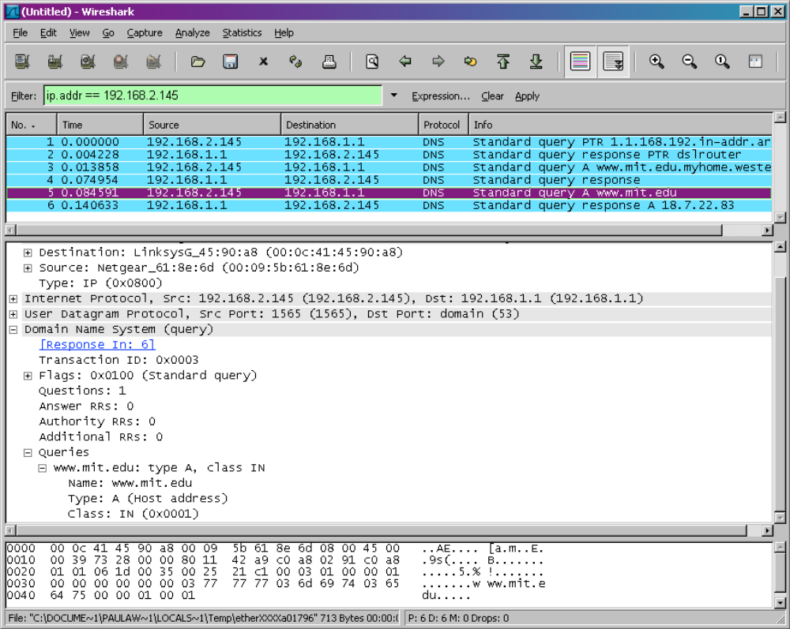
Tracing DNS with Wireshark
Now let’s play with
nslookup.
  Start packet capture.
  Do an nslookup on www.mit.edu
  Stop packet capture.

Slide 13
Tracing DNS with Wireshark
In answering the following questions, ignore the first two sets of queries/responses, as they are specific to nslookup and are not normally generated by standard Internet applications. You should instead focus on the last query and response messages
11. What is the destination port for the DNS query message? What is the source port of DNS response message?
12. To what IP address is the DNS query message sent? Is this the IP address of your default local DNS server?
13. Examine the DNS query message. What “Type” of DNS query is it? Does the query message contain any “answers”?
14. Examine the DNS response message. How many “answers” are provided? What do each of these answers contain?
15. Provide a screenshot..

Slide 14
Tracing DNS with Wireshark
In answering the following questions, ignore the first two sets of queries/responses, as they are specific to nslookup and are not normally generated by standard Internet applications. You should instead focus on the last query and response messages
11. What is the destination port for the DNS query message? What is the source port of DNS response message?
12. To what IP address is the DNS query message sent? Is this the IP address of your default local DNS server?
13. Examine the DNS query message. What “Type” of DNS query is it? Does the query message contain any “answers”?
14. Examine the DNS response message. How many “answers” are provided? What do each of these answers contain?
15. Provide a screenshot..

Slide 15
Tracing DNS with Wireshark
Now repeat the previous experiment, but instead issue the command: nslookup –type=NS mit.edu
Answer the following questions5 :
16. To what IP address is the DNS query message sent? Is this the IP address of your default local DNS server?
17. Examine the DNS query message. What “Type” of DNS query is it? Does the query message contain any “answers”?
18. Examine the DNS response message. What MIT nameservers does the response message provide? Does this response message also provide the IP addresses of the MIT namesers?
19. Provide a screenshot.

Slide 16
Tracing DNS with Wireshark
Now repeat the previous experiment, but instead issue the command:
nslookup www.aiit.or.kr bitsy.mit.edu
Answer the following questions6:
20. To what IP address is the DNS query message sent? Is this the IP address of your default local DNS server? If not, what does the IP address correspond to?
21. Examine the DNS query message. What “Type” of DNS query is it? Does the query message contain any “answers”?
22. Examine the DNS response message. How many “answers” are provided? What
does each of these answers contain?
23. Provide a screenshot.

